Slide 1
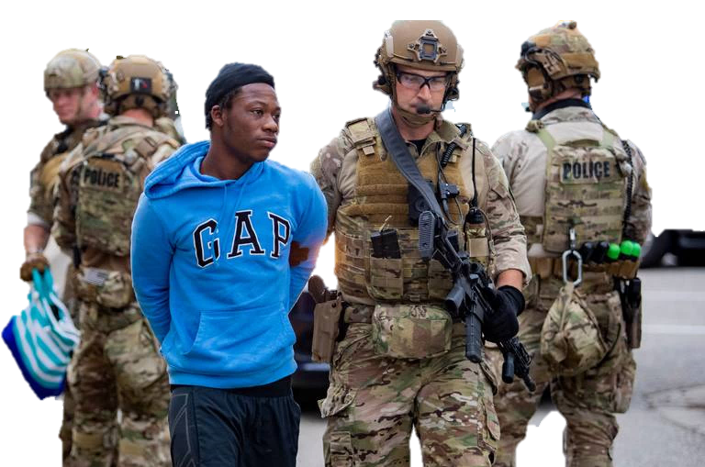
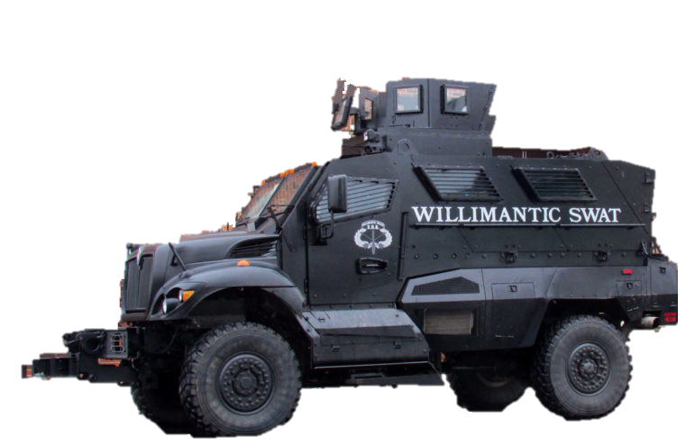
POLICE FATALITY AND MILITARY SURPLUS PURCHASING
12NOV2020
AUTHOR: CHRISTOPHER OBLAK
DUKE MIDS

Slide 2
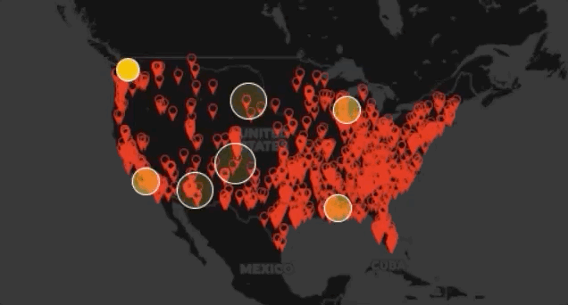
INTRODUCTION
Trend of police militarization and police incurred deaths have been apparently rising
- The 1033 Program:
Created by the National Defense Authorization Act for Fiscal Year 1997
Allowed law enforcement agencies to acquire military hardware.
Key Questions I investigated:
1. Is there a relationship between the overall military surplus value a state police departments spend and the normalized police brutality rate to their population?
2. Are there specific equipment (weapons vs. officer equipment as an example) that provide better indicators of police-involved deaths?
2019 Police Cause Over 1000 Deaths - Source: Forbes
Summary
There are slight variations between States
As Police and Trooper Departments increase the use of Body Camera Usage from the ratio category of 0-40%, the rate of deaths decease
As total spending on Military Surplus increase, there is evidence that that rates of deaths cause by police/trooper departments increase
As the ratio of Mil Surplus spending increase for Police/Trooper departments so dies the rate of deaths

Slide 3
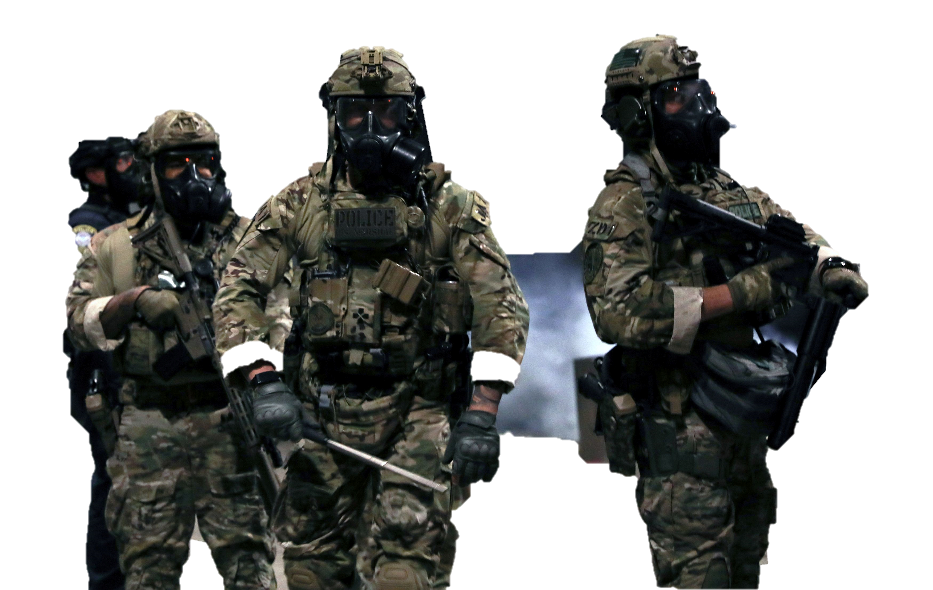
DATA
Data Sources
• Washington Post – Police Fatality Shooting Data set from 2015-2019
• Defense Logistics Agency – 1033 Program from late 1990’s to present
(https://www.dla.mil/DispositionServices/Offers/
Reutilization/LawEnforcement/JoinTheProgram.aspx)
• US Census Bureau – Population Data for State from 2015-2019
Data Assumptions
• The events occur independently
• The events occur at random
• The probability of an event occurring in a given time interval does not vary with time
Data Distribution
Number Of States Represented For Each Year
2013 | 2014 | 2015 | 2016 | 2017 | 2018 | 2019
48 | 49 | 44 | 45 | 46 | 47 | 44
After merging and aggregating the data we
have enough data to continue

Slide 4
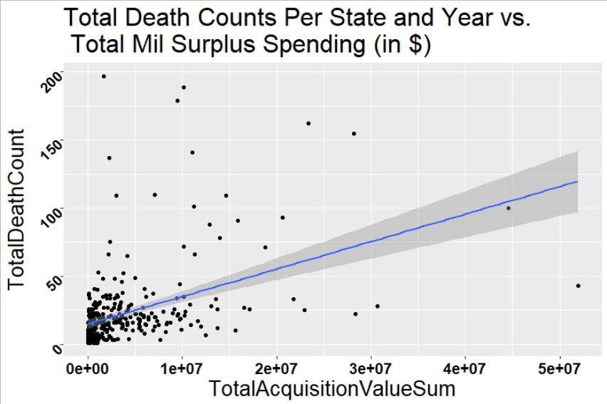
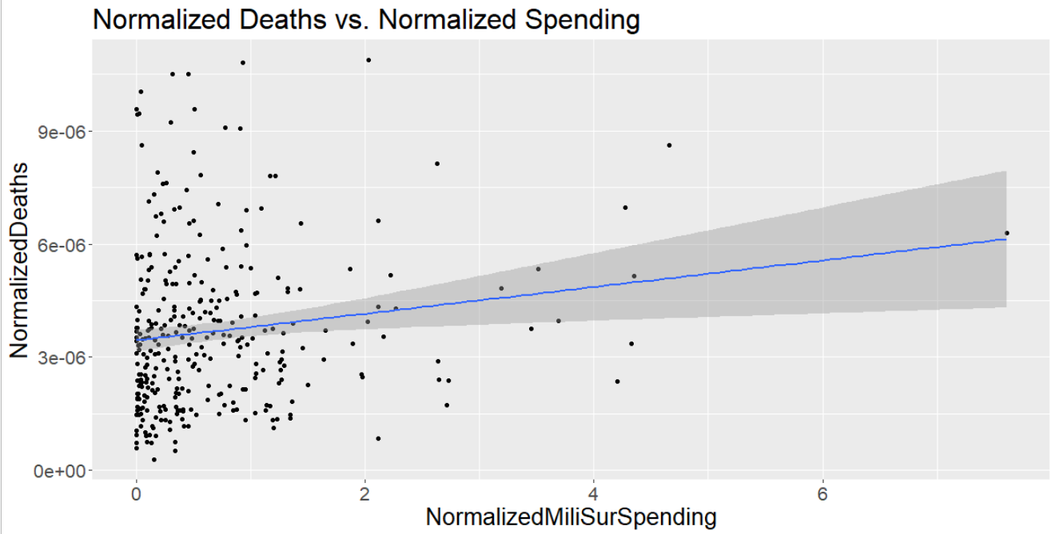
EDA
First Plot of the total count of deaths per state/year vs. the spending that state spend on military surplus.
- Potential upward trend, but cluster of data in the bottom left make it very hard to tell
Normalized Deaths per state/year vs. the normalized spending that state spend on military surplus.
- Potential upward trend, but pull from potential outliers are a concern

Slide 5
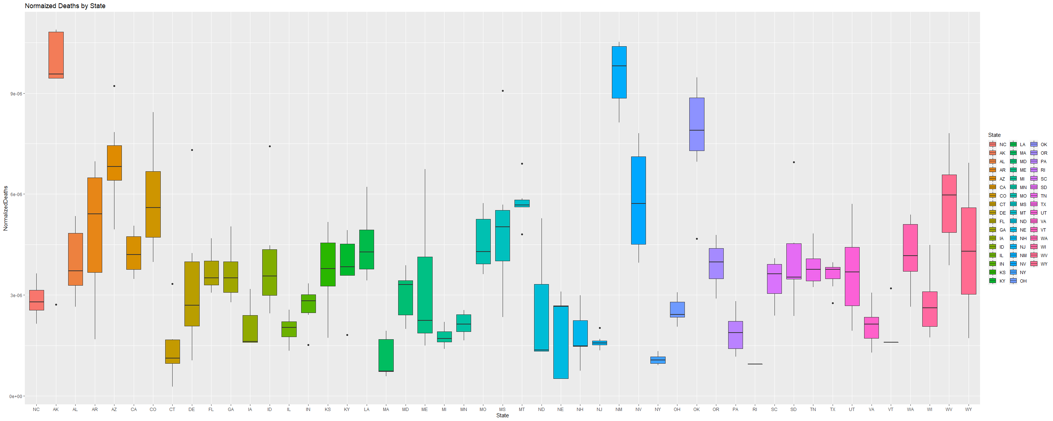
EDA
Boxplots of Individual State Normalized Death Values
Normalized Death Values
States
Boxplot of Normalized Deaths grouped by state.
- Large variation that would dictate hierarchical grouping

Slide 6
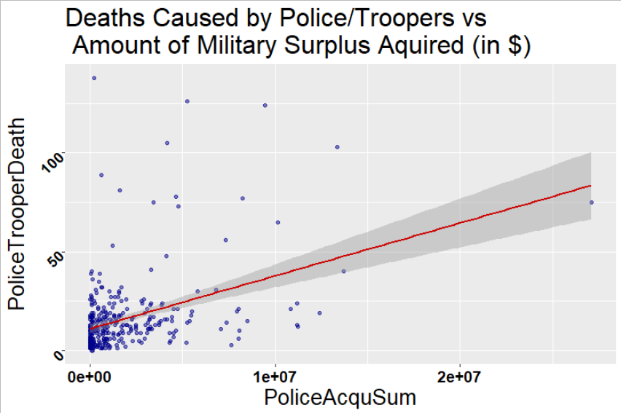
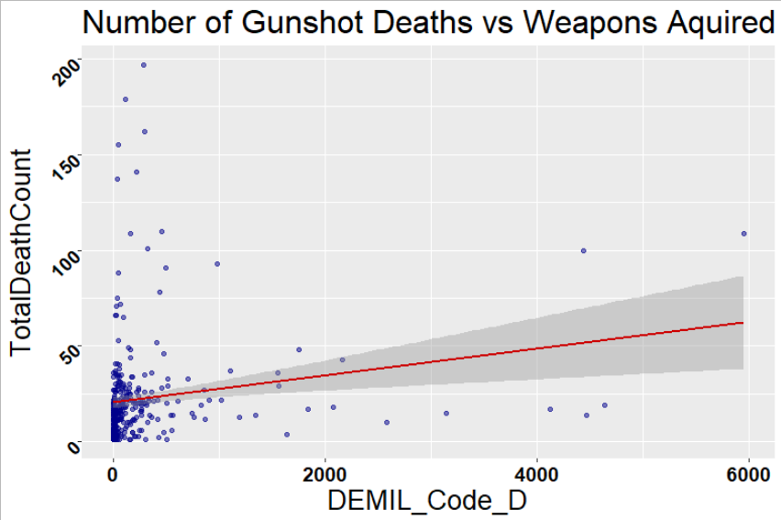
EDA
Gunshot Related Deaths vs Weapons Acquired (Per State and Year)
- Similar graph to original plot, potential upward trend, but two much skew toward the bottom left to be confident about it.
Strictly Police Spending vs Police Deaths (Per State and Year)
- This was the strongest correlation of trend I saw.

Slide 7
Finalized Data After EDA
Response Variable
Variable | Description | Source of Data
Year | Year data was collected 2014-2019 | WSP, 1033, USCB
State | State of Police Fatalities and Surplus Bought | WSP, 1033
TotalDeathCount | Total Police Fatality for the year and state | WSP
Population | Population estimate for each state by year | USCB
BodyCamUsageCat | Category of Body Cam Usage in Fatality Shooting ("0-40%", "40-55%", "55-70%", "70-85%", "85-100%") | WSP ***
TotalAcquisitionValueSum | Total Money Spent on Military Surplus by State and Year | 1033 ***
NormalizedDeaths | Total Deaths normailized by the popualtion | WPS & USCB ***
NormalizedMiliSurSpending | Total Military Surplus Spending by each State | 1033***
PoliceSpendingCat | Precentage of Police Dept Spending of the Total ("0-40%", "40-60%", "60-100%") | 1033 ***
SheriffSpendingCat | Precentage of Sheriff Dept Spending of the Total ("0-40%", "40-60%", "60-100%") | 1033 ***
DEMIL_Code_A | Number of Mis Equipment (tents, fridges, backpacks, ect) | 1033 ***
DEMIL_Code_B | Number of Tools and Aircraft Equipment | 1033 ***
DEMIL_Code_C | Number of Tactical Vehicles | 1033 ***
DEMIL_Code_D | Number of Weapons | 1033 ***
DEMIL_Code_E | Number of Uniforms / Personal Equipment | 1033 ***
DEMIL_Code_F | Number of Weapons Scopes and Auxiliary | 1033 ***
DEMIL_Code_Q | EUD Robots, Repair Parts, Tools, Non Tactical Equipment
PoliceAcquSum | Aggrigated amount spent by poilce deparmtents from the over all state spendings | 1033 ***
PoliceCount | Number of fatalities cuased by police department personell | WSP ***
SheriffAcquSum | Aggrigated amount spent by sheriff/marshall deparmtents from the over all state spendings | 1033 ***
SheriffCount | Number of fatalities caused by sheriff department personnel | WSP ***
PublicSafetyAcquSum | Aggrigated amount spent by highway safety/wildlife/fishing/mis deparmtents from the over all state spendings | 1033 ***
PoliceTrooperDeath | Number of fatalities caused by highway safety/wildlife/fishing/mis department personnel | WSP ***
Year14 | Readjusted year from 1-7 | WSP, 1033, USCB
Data Source Key: WSP = Washington Post, 1033 = US Govn't 1033 Surplus Plan, USCB = US Census Bureau (***Calculated from available data)

Slide 8
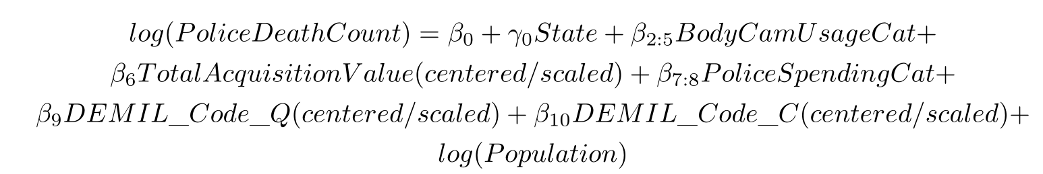
MODEL SELECTION
Initial Response Variable was TotalDeathCount (the variable that accounted for all law enforcement related deaths in a state in a given year)
- Over all the only statistically significant variables made little to no sense
Saw a correlation between police/trooper departments and shifted focus to only police/trooper department induced fatalities
FINAL MODEL SELECTION
FINAL MODEL NOTES:
I investigated DEMIL_Code_D (Weapon Purchasing), as it was a primary question I had, but found it to be unsignificant when conducting an ANOVA test.
Focusing on Police/Trooper Dept fatalities, and not Total Law Enforcement allowed my model to preform better, and directly answer the question I was interested in.

Slide 9
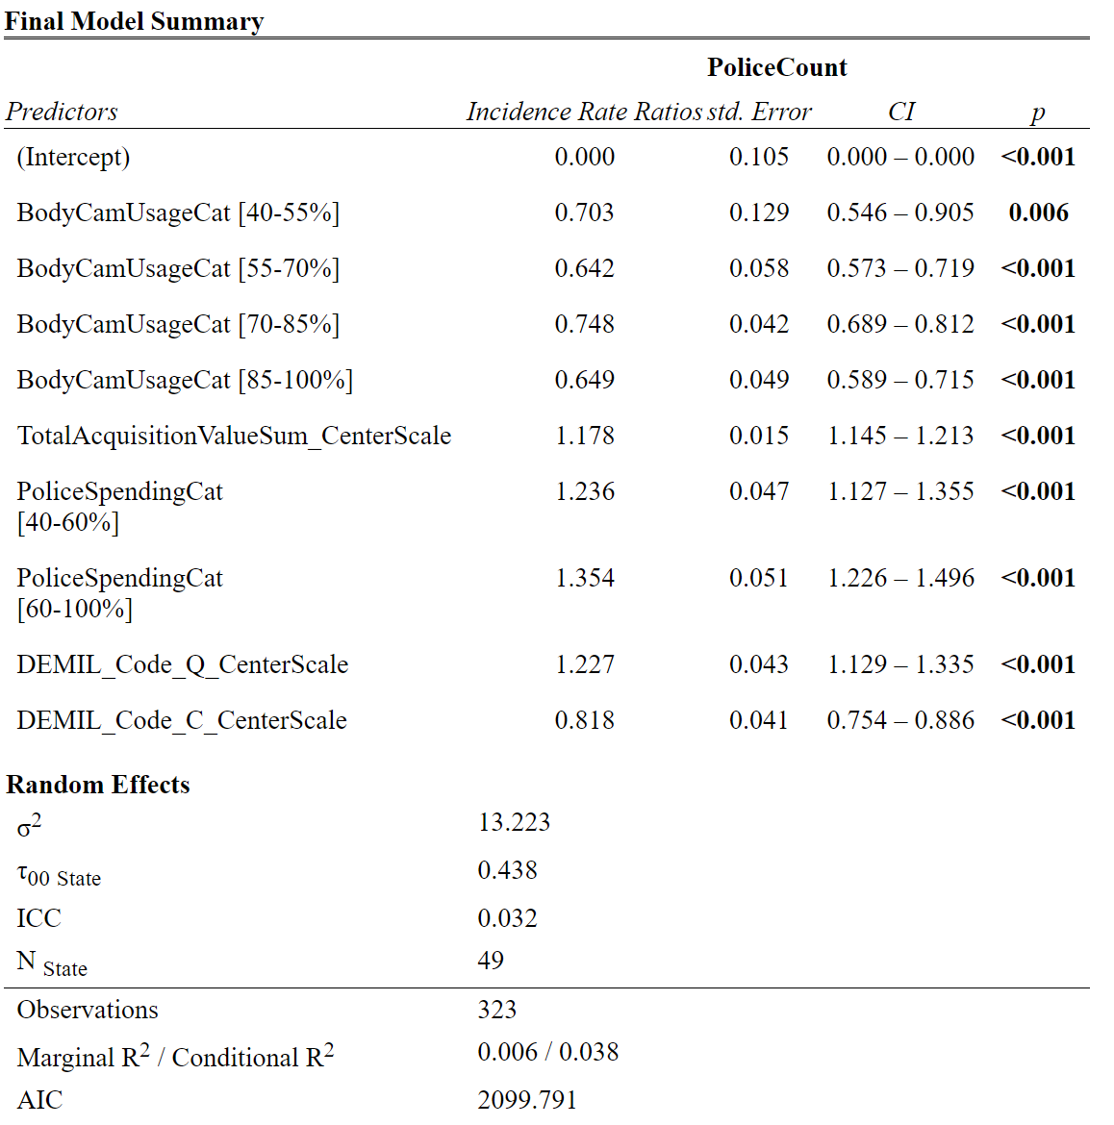
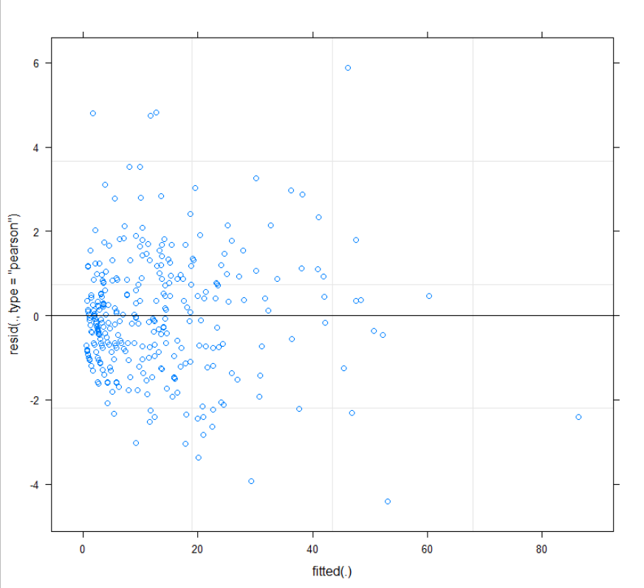
FINAL MODEL SELECTION CONTINUE
Residual vs Fitted Plot

Slide 10
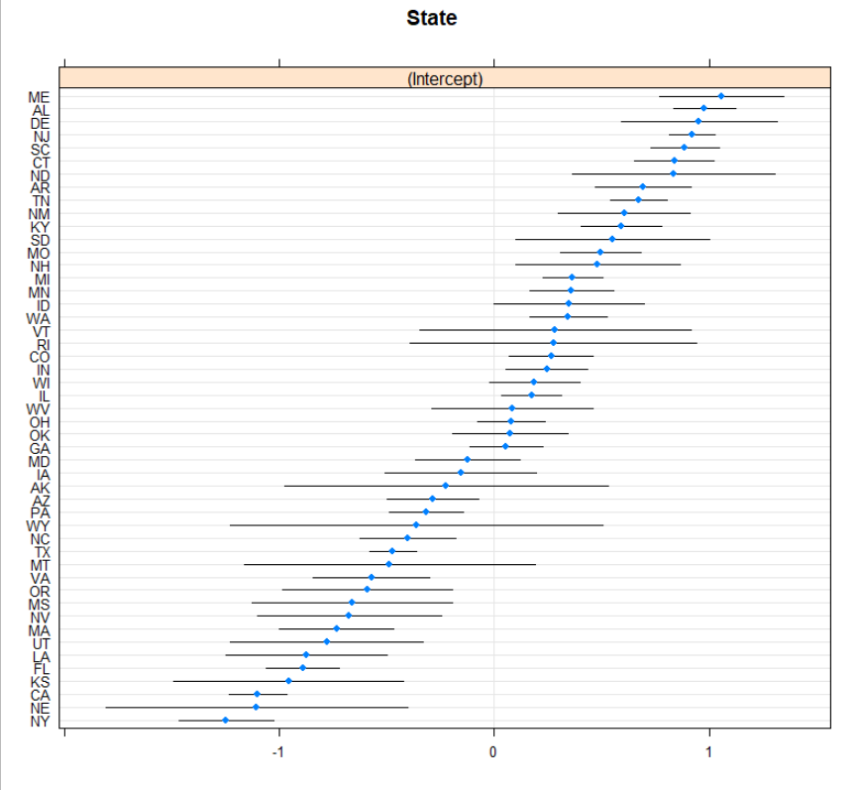
FINAL MODEL SELECTION CONTINUE
Interpretation of Random Effects

Slide 11
CONCLUSION
Model Interpretation:
Random Effect – State standard deviation is low for the varying intercepts, meaning States varying some but not much.
As body camera usage increases from the range of 0-40% (while all else holds the same) , we see police/trooper department related death fatalities decrease with a high level of statistical significance:
(40-55% usage): 30% |(55-70% usage): 36% |(70-85% usage): 26% |(85-100% usage): 25%
As total money in the state is increased from the mean standard the likely hood of increased death cause by police/trooper departments increase by 18%
As the ratio of total money in the state on Mil Surplus going to police/trooper departments increase, the rate in which death occur increase: (40-60% usage): 24% |(60-100% usage): 35%
As total number of DEMIL-ed equipment under the “Q” category (EUD Robots, Repair Parts, Tools, Non Tactical Equipment) increases on the mean standard scale, and while everything else holds the same, death counts increase at 23%
As total number of DEMIL-ed equipment under the “C” category (General Tactical Vehicles) increases
on the mean standard scale, and while everything else holds the same,
death counts decrease at 18%
Limitation:
Police Spending only covered Mil Surplus, and not commercial off the
shelf equipment (Multicamp CRE Top and Bottoms = +$450).
Full Police Budget comparison (Mil Type of Equip vs. Policing Equip)
Categorizing DEMIL codes vs. Actual Equipment Types
Investigating States Independently and the difference between Sheriff and Police Departments

